Slide 1
CENG-232 Logic Design
Week 9 - Memory and Programmable Logic

Slide 2
Memory
All sequential circuits depend upon the presence of memory.
A memory unit = collection of storage cells + circuits needed to transfer data in and out

Slide 3
Memory
Two types of memory used in digital systems:
RAM: Random Access Memory
ROM: Read-Only Memory
RAM can perform both read and write
ROM can perform only the read operation
ROM is also considered a Programmable Logic Device (more on this later)

Slide 4

RAM: Random Access Memory
Why random-access?
The time it takes to transfer information to or from any desired random location is always the same.
Compare this with a tape unit.

Slide 5
Bits, bytes and words
A memory unit stores binary information in groups of bits called words.
A word is an entity of bits that move in and out of storage as a unit.
A memory word may represent
a number,
an instruction,
one or more alphanumeric characters, or
any other binary‐coded information.
Most computer memories use words that are multiples of 8 bits in length which is a byte.
Notes:
Int I;
Int* p = &i;
P++? Ne kadar arttirir? 1 mi? 4 mu?
Relate the information above to your C knowledge. What does sizeof(int) and sizeof(char) return?

Slide 6
Introduction to RAM
A RAM should be able to:
- Store many words, one per address
- Read the word that was saved at a particular address
- Change the word that’s saved at a particular address
Random-Access Memory (or RAM), provides large quantities of temporary storage in a computer system.
Remember the basic capabilities of a memory:
It should be able to store a value.
You should be able to read the value that was saved.
You should be able to change the stored value.
A RAM is similar, except that it can store many values, and access times for different locations are the same.
An address will specify which memory value we’re interested in.
Each value can be a multiple-bit word (e.g., 8 bits, 32 bits).
We’ll refine the memory properties as follows:

Slide 7
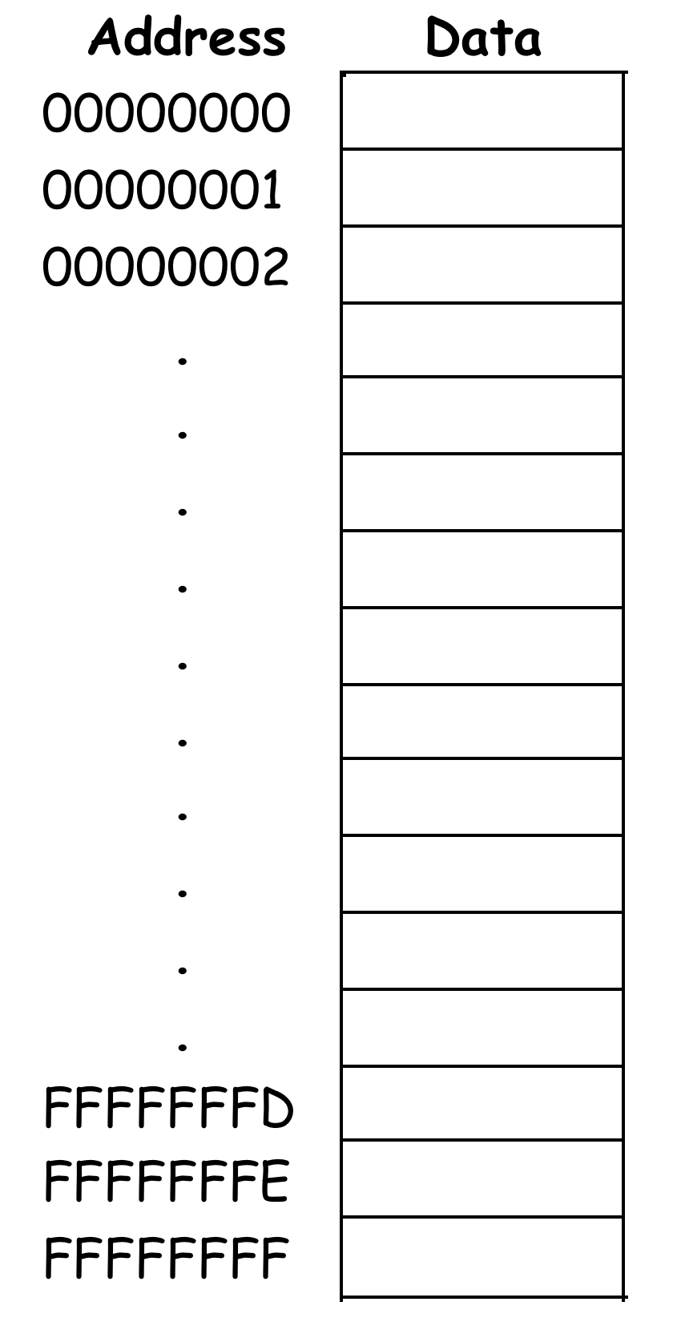
Picture of Memory
You can think of computer memory as being one big array of data.
The address serves as an array index.
Each address refers to one word of data.
You can read or modify the data at any given memory address.
You’ve worked with pointers in C (or C++), so you’ve already worked with memory addresses.

Slide 8
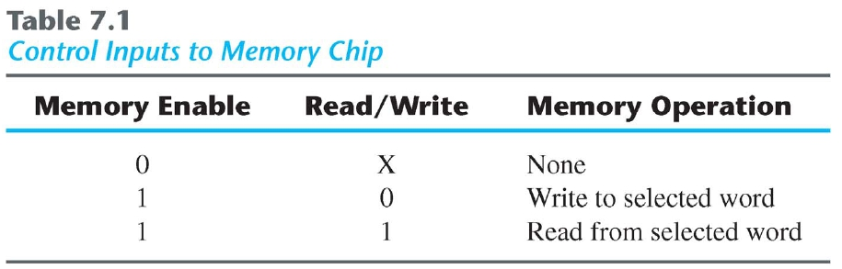
Memory as a Black-Box
The number of address bits needed in a memory
??? the total number of words that can be stored in the memory
??? the number of bits in each word.
Replace “???” with “depends on” or “is independent from”
n data input lines
k address lines
Read/Write
Enable
Memory Unit
2^{k} words
n bit per word
n data output lines
(a) Depends (b) indep

Slide 9
Block diagram of RAM
2^{k} x n memory
ADRS OUT
DATA CS
WR
k
n
n
This block diagram introduces the main interface to RAM.
A Chip Select, CS, enables or disables the RAM.
ADRS specifies the address or location to read from or write to.
WR selects between reading from or writing to the memory.
To read from memory, WR should be set to 0.
OUT will be the n-bit value stored at ADRS.
To write to memory, we set WR = 1.
DATA is the n-bit value to save in memory.
This interface makes it easy to combine RAMs together, as we’ll see.

Slide 10
Memory sizes
2^{k} x n memory
ADRS OUT
DATA CS
WR
k
n
n
We refer to this as a 2^{k} x n memory.
There are k address lines, which can specify one of 2^{k} addresses.
Each address contains an n-bit word.
For example, a 2²⁴ x 16 RAM contains 2²⁴ = 16M words, each 16 bits long.
The RAM would need 24 address lines.
The total storage capacity is 2²⁴ x 16 = 2²⁸ bits.

Slide 11
Memory sizes
Memory sizes are usually specified in numbers of bytes (8 bits), megabytes or gigabytes.
The 2²⁸-bit memory on the previous page translates into:
2²⁸ bits / 8 bits per byte = 2²⁵ bytes
With the abbreviations below, this is equivalent to 32 megabytes.

Slide 12
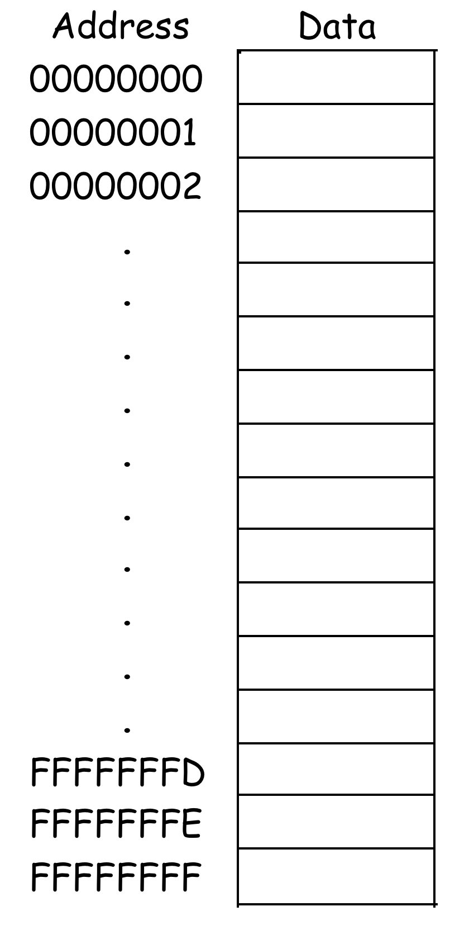
Typical Memory Sizes
Some typical memory capacities:
PCs usually come with 8GB to 16GB of RAM.
Smartphones have 2-4GB of memory.
But… Many operating systems implement Virtual Memory, which makes the memory larger than RAM’s capacity.
If a system uses 32-bit addresses, this works out to 2³², or about four billion, different possible addresses.
With a data (word) size of one byte, the result is apparently a 4GB memory.
For 64-bit addresses, the theoretical limit is 16 Exabytes. (1 Exabyte = 10^(18) bytes)
The operating system uses hard disk space as a substitute for “real” memory (VM).

Slide 13
Reading RAM
To read from this RAM, the controlling circuit must:
Enable the chip by ensuring CS = 1.
Select the read operation, by setting WR = 0.
Send the desired address to the ADRS input.
The contents of that address appear on OUT after a little while.
Notice that the DATA input is unused for read operations.
2^{k} x n memory
ADRS OUT
DATA CS
WR
k
n
n
1
0

Slide 14
Memory Read Cycle
The memory does not employ an internal clock.
The operation of the memory unit is controlled by an external device such as a central processing unit (CPU).
The CPU is usually synchronized by its own clock.
Memory read and write operations are specified by control inputs.
The access time of memory is the time required to select a word and read it.
The cycle time of memory is the time required to complete a write operation.

Slide 15
Memory Read Cycle
Timing Diagram example in the next slide.
Suppose the CPU operates at 50MHz (=20 ns for one clock cycle)
Also suppose the access and cycle time of the memory do not exceed 50 ns

Slide 16
Memory Read Cycle
Timing Diagram.
50 nsec
T1
T2
T3
T1
Clock
Memory
address
Memory
enable
Read/
Write
Data
output
Address valid
Initiate read
Data valid

Slide 17
Writing RAM
To write to this RAM, you need to:
Enable the chip by setting CS = 1.
Select the write operation, by setting WR = 1.
Send the desired address to the ADRS input.
Send the word to store to the DATA input.
The output OUT is not needed for memory write operations.
2^{k} x n memory
ADRS OUT
DATA CS
WR
k
n
n
1
1

Slide 18
Memory Write Cycle
Timing Diagram
20 nsec
T1
T2
T3
T1
Clock
Memory
address
Memory
Address valid
enable
Read/
Write
Data
input
Initiate writing
Latched
Data valid

Slide 19
Types of Memories
Static and Dynamic
Static RAM (SRAM) consists of internal latches
The stored data remains valid as long as the power is supplied to the unit.
Why use latches instead of flip flops?
A latch can be made with only two NAND or two NOR gates, but a flip-flop requires at least twice that much hardware.
In general, smaller is faster, cheaper and requires less power.
The tradeoff is that getting the timing exactly right is a pain.

Slide 20
Dynamic memory
Dynamic RAM (DRAM) is built with capacitors.
A stored charge on the capacitor represents a logical 1.
No charge represents a logic 0.
However, capacitors lose their charge after a few milliseconds. The memory requires constant refreshing to recharge the capacitors. (That’s what’s “dynamic” about it.)
Dynamic RAMs tend to be physically smaller than static RAMs.
A single bit of data can be stored with just one capacitor and one transistor, while static RAM cells typically require 4-6 transistors.
This means dynamic RAM is cheaper and denser—more bits can be stored in the same physical area.
DRAM offers reduced power consumption and larger storage capacity in a single memory chip.
SRAM is easier to use and has shorter read and write cycles.

Slide 21
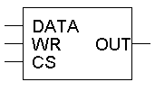
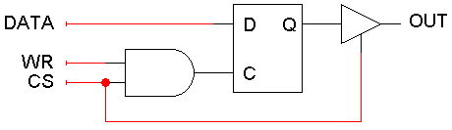
Starting with Latches
To start, we can use one latch to store each bit. A one-bit RAM cell is shown here.
Since this is just a one-bit memory, an ADRS input is not needed.
Writing to the RAM cell:
When CS = 1 and WR = 1, the latch control input will be 1.
The DATA input is thus saved in the D latch.
Reading from the RAM cell and maintaining the current contents:
When CS = 0 or when WR = 0, the latch control input is also 0, so the latch just maintains its present state.
The current latch contents will appear on OUT.

Slide 22
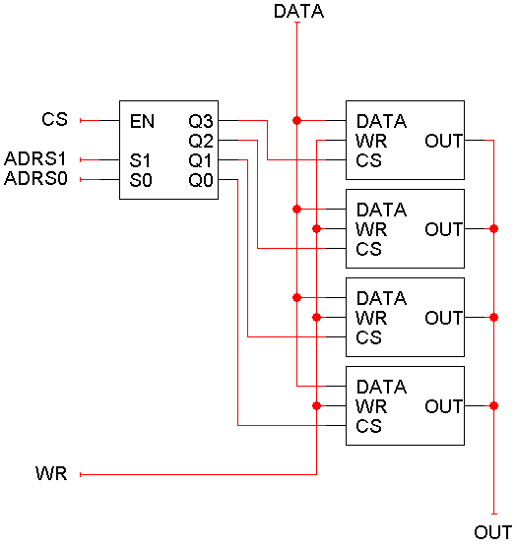
Let’s build our first RAM
We can use these cells to make a 4 x 1 RAM.
Since there are four words, ADRS is two bits.
Each word is only one bit, so DATA and OUT are one bit each.
Word selection is done with a decoder attached to the CS inputs of the RAM cells. Only one cell can be read or written at a time.
Notice that the outputs are connected together with a single line!

Slide 23
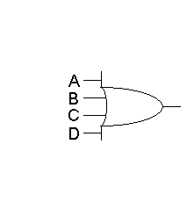
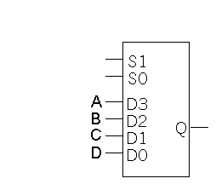
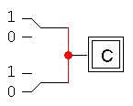
Connecting outputs together
In normal practice, it’s bad to connect outputs together. If the outputs have different values, then a conflict arises.
The standard way to “combine” outputs is to use OR gates (?) or muxes.
This can get expensive, with many wires and gates with large fan-ins.

Slide 24
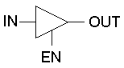
Three-State Buffers
The triangle represents a three-state buffer.
Unlike regular logic gates, the output can be one of three different possibilities, as shown in the table.
“Disconnected” means no output appears at all, in which case it’s safe to connect OUT to another output signal.
The disconnected value is also sometimes called high impedance or Hi-Z.

Slide 25
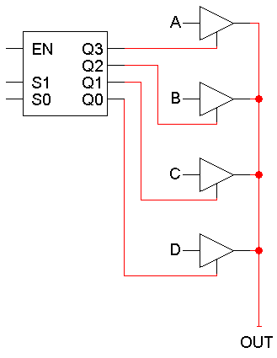
Connecting Three-State Buffers
You can connect several three-state buffer outputs together if you can guarantee that only one of them is enabled at any time.
The easiest way to do this is to use a decoder!
If the decoder is disabled, then all the three-state buffers will appear to be disconnected, and OUT will also appear disconnected.
If the decoder is enabled, then exactly one of its outputs will be true, so only one of the tri-state buffers will be connected and produce an output.
The net result is we can save some wire and gate costs. We also get a little more flexibility in putting circuits together.

Slide 26
Bigger and Better
Here is the 4 x 1 RAM once again.
How can we make a “wider” memory with more bits per word, like maybe a 4 x 4 RAM?
Duplicate the stuff in the green box!

Slide 27
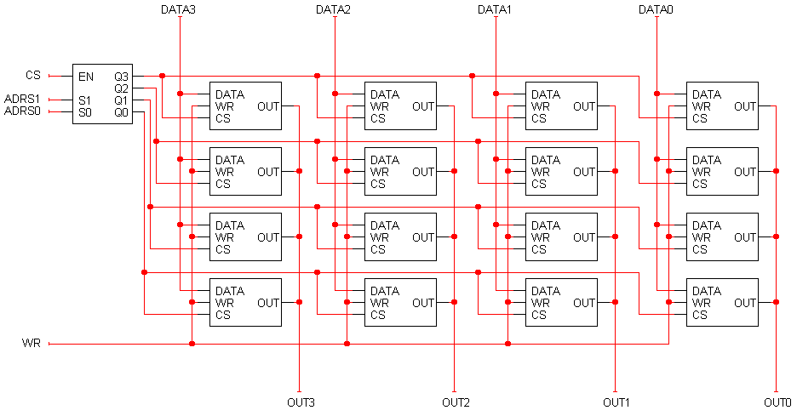
A 4 x 4 RAM
DATA and OUT are now each four bits long, so you can read and write four-bit words.

Slide 28
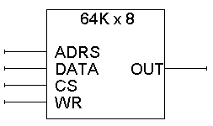
Bigger RAMs from smaller RAMs
We can use small RAMs as building blocks for making larger memories, by following the same principles as in the previous examples.
As an example, let’s construct a 256Kx8 RAM using 64K x 8 RAMs:
How many address lines? How many data lines?
64K = 2⁶ x 2¹⁰ = 2¹⁶, so there are 16 address lines.
There are 8 data lines.
16
8
8

Slide 29
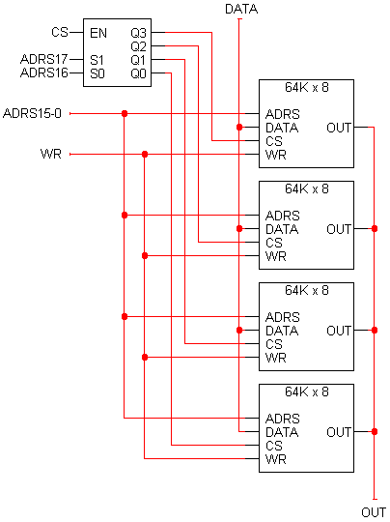
Constructing a larger memory
We can put four 64K x 8 chips together to make a 256K x 8 memory.
For 256K words, we need 18 address lines.
The two most significant address lines go to the decoder, which selects one of the four 64K x 8 RAM chips.
The other 16 address lines are shared by the 64K x 8 chips.
The 64K x 8 chips also share WR and DATA inputs.
This assumes the 64K x 8 chips have three-state outputs.
8
16
8

Slide 30
Analyzing the 256K x 8 RAM
There are 256K words of memory, spread out among the four smaller 64K x 8 RAM chips.
When the two most significant bits of the address are 00, the bottom RAM chip is selected. It holds data for the first 64K addresses.
The next chip up is enabled when the address starts with 01. It holds data for the second 64K addresses.
The third chip up holds data for the next 64K addresses.
The final chip contains the data of the final 64K addresses.
8
16
8

Slide 31
Address ranges
8
16
11 1111 1111 1111 1111 (0x3ffff)
to
11 0000 0000 0000 0000 (0x30000)
10 1111 1111 1111 1111 (0x2ffff)
to
10 0000 0000 0000 0000 (0x20000)
01 1111 1111 1111 1111 (0x1ffff)
to
01 0000 0000 0000 0000 (0x10000)
00 1111 1111 1111 1111 (0x0ffff)
to
00 0000 0000 0000 0000 (0x00000)
8

Slide 32
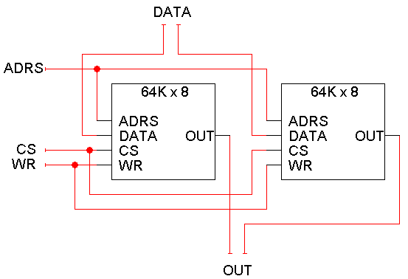
Making a wider memory
You can also combine smaller chips to make wider memories, with the same number of addresses but more bits per word.
Here is a 64K x 16 RAM, created from two 64K x 8 chips.
The left chip contains the most significant 8 bits of the data.
The right chip contains the lower 8 bits of the data.
8
8
16
8
8

Slide 33
Binary Cell
Select
Select
Input
BC
Output
Output
Input
S
R
Read/Write
Block Diagram
Read/Write
Logical Equivalent
Physical implementation of BC:
SRAM: Uses a latch (has ~6 transistors)
DRAM: A MOS transistor and a capacitor

Slide 34
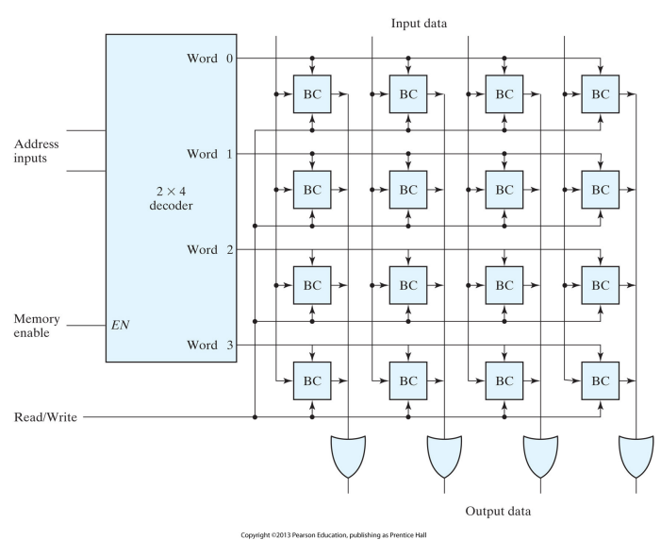
Cell Access
Each row is a word.

Slide 35
Cell Access
Each row is a word.
We use decoders to select words and this could easily become very costly!!

Slide 36
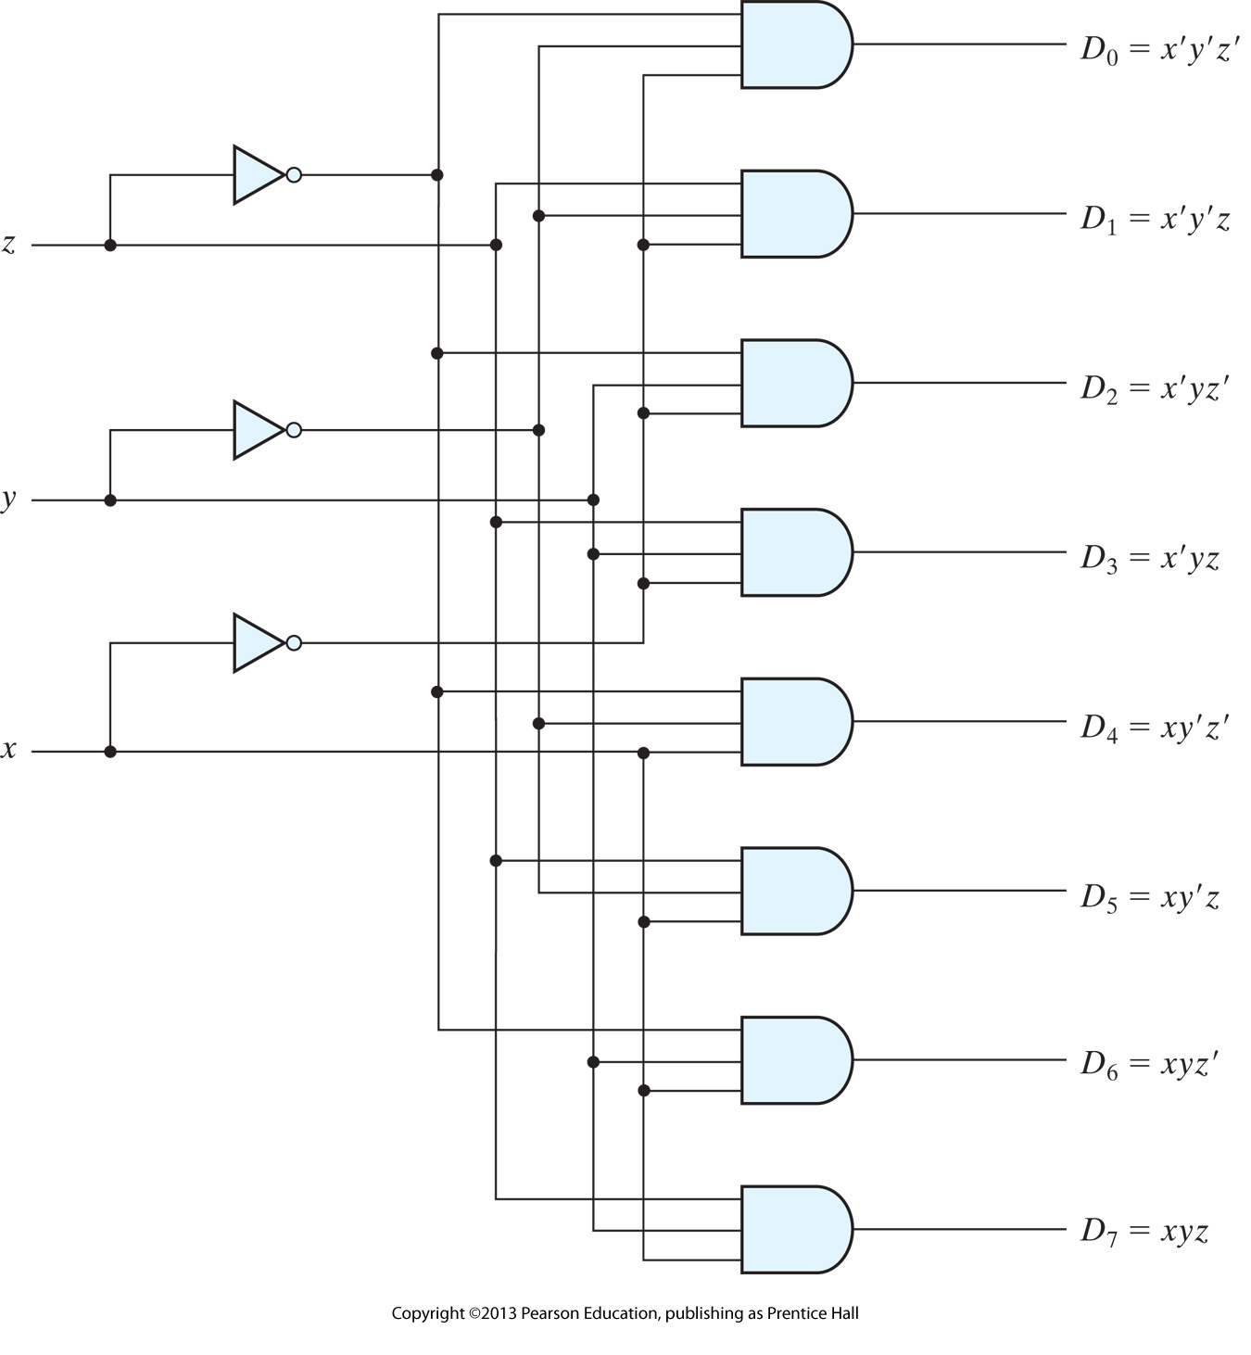
Decoder reminder
This is a 3-to-2^3 decoder.

Slide 37
Suppose we want to implement a memory that has 1K (1024) words.
What size decoder do we need?
How many AND gates does it have?
Notes:
10 x 1024
1024 AND gates with 10 inputs in each

Slide 38
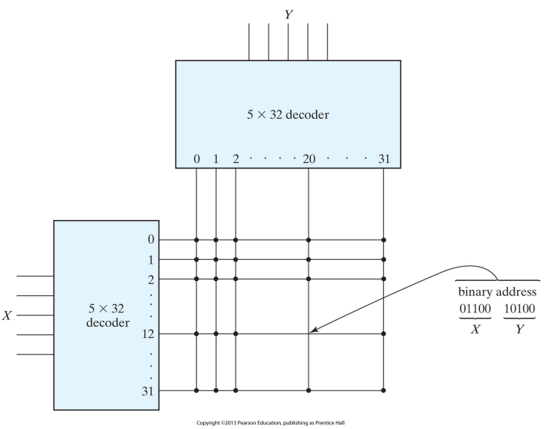
2D Decoding 1K-Word Memory
Goal: reduce the implementation cost of the decoders.
How many AND gates are required in a 10x1024 decoder?
How many AND gates are required in a 5x32 decoder?
This is address 404, why?
Note that each intersection represents a word that may have any number of bits.
Notes:
12*32 + 20 = 404

Slide 39
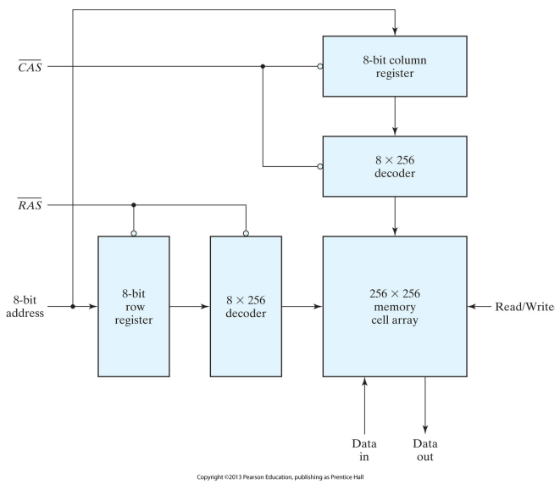
Address Multiplexing
Goal: reduce the number of pins in the IC (integrated-circuit) package.
RAS (row address strobe) enables the row register.
CAS (column address strobe) enables the column register.

Slide 40
Error Correction
Murphy’s law: "Anything that can go wrong, will go wrong."
Memory is no exception! Some bit will flip once in a while..
The dynamic physical interaction of the electrical signals affecting the data path of a memory unit may cause occasional errors in storing and retrieving the binary information.
We need to
Detect whether there is an error
Correct it, if possible

Slide 41
Error Correction
Use extra bits
For instance append a parity bit (remember this? How was it implemented? )
For more interesting methods read the related section of the book. (Section 7.4)

Slide 42
RAM Summary
A RAM looks like a bunch of registers connected together, allowing users to select a particular address to read or write.
Much of the hardware in memory chips supports this selection process:
Chip select inputs
Decoders
Tri-state buffers
By providing a general interface, it’s easy to connect RAMs together to make “longer” and “wider” memories.

Slide 43
Dynamic vs. Static Memory
Dynamic RAM: uses capacitors and transistors
Static RAM: uses latches
In practice, dynamic RAM is used for a computer’s main memory, since it’s cheap and you can pack a lot of storage into a small space.
These days you can buy 2GB of memory for 60 liras.

Slide 44
Dynamic vs. Static Memory
The disadvantage of dynamic RAM is its speed.
Access and cycle times are long compared to CPU’s clock period.
Real systems augment dynamic memory with small but fast sections of static memory called caches.
Typical processor caches range in size from 128KB to 320KB.
That’s small compared to a 4GB main memory, but it’s enough to significantly increase a computer’s overall speed.
You’ll study caches later on in CENG331 next semester.

Slide 45
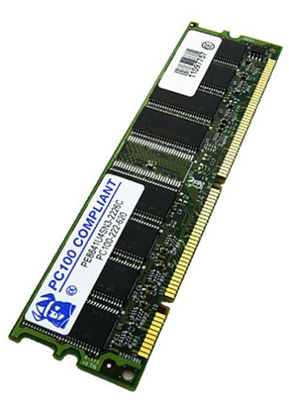
SDRAM
Synchronous DRAM, or SDRAM, is one of the most common types of PC memory now.
Memory chips are organized into “modules” that are connected to the CPU via a 64-bit (8-byte) bus.
Speeds are rated in megahertz: PC66, PC100 and PC133 memory run at 66MHz, 100MHz and 133MHz respectively.
The memory bandwidth can be computed by multiplying the number of transfers per second by the size of each transfer.
PC100 can transfer up to 800MB per second (100MHz x 8 bytes/cycle).
PC133 can get over 1 GB per second.

Slide 46
DDR-RAM
A newer type of memory is Double Data Rate, or DDR-RAM.
It’s very similar to earlier SDRAM, except data can be transferred on both the positive and negative clock edges. For 100-133MHz buses, the effective memory speeds appear to be 200-266MHz.
This memory is confusingly called PC1600 and PC2100 RAM, because
200MHz x 8 bytes/cycle = 1600MB/s
266MHz x 8 bytes/cycle = 2100MB/s.
DDR-RAM has lower power consumption, using 2.5V instead of 3.3V like SDRAM. This makes it good for notebooks and other mobile devices.

Slide 47
DDR-RAM
DDR2
Power savings are achieved primarily due to an improved manufacturing process through die shrinkage, resulting in a drop in operating voltage (1.8 V compared to DDR's 2.5 V).
DDR3
At 100 MHz, DDR3 SDRAM gives a maximum transfer rate of 6400 MB/s.
1.5V
DDR4
At 200 MHz, DDR4 SDRAM gives a maximum transfer rate of 12800 MB/s.
1.2 V
DDR5
Released in 2020
Doubles the rates of DDR4
1.1 V

Slide 48
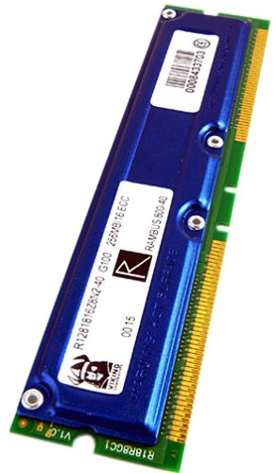
RDRAM
Another new type of memory called RDRAM is used in the Playstation 2 as well as some Pentium 4 computers.
The data bus is only 16 bits wide.
But the memory runs at 400MHz, and data can be transferred on both the positive and negative clock edges.
That works out to a maximum transfer rate of 1.6GB per second.
You can also implement two “channels” of memory, resulting in up to 3.2GB/s of bandwidth.

Slide 49
Programmable Logic

Slide 50
Programmable Logic Devices (PLDs)
PLD is a re-configurable IC
Built with large numbers of gates connected through electronic fuses to implement arbitrary circuits.
Types:
Programmable ROM (read-only memory)
Programmable Logic Array (PLA)
Programmable Array Logic (PAL)
FPGA

Slide 51
Read-Only Memory
2^{k} x n ROM
ADRS OUT
CS
k
n
A read-only memory, or ROM, is a special kind of memory whose contents cannot be easily modified.
The WR and DATA inputs that we saw in RAMs are not needed.
Data is stored onto a ROM chip using special hardware tools.
ROMs are useful for holding data that never change.
Arithmetic circuits might use tables to speed up computations of logarithms or divisions.
Many computers use a ROM to store important programs that should not be modified, such as the system BIOS.
PDAs, game machines, cell phones, vending machines and other electronic devices may also contain non-modifiable programs.

Slide 52
ROM Structure
k address lines
• • •
inputs
Memory Array (2^{k} words by n bits)
Decoder
2^{k} word lines
outputs
• • •
n data lines

Slide 53
Memories and functions
ROMs are actually combinational devices, not sequential ones!
(Once set) The same address will always contain the same data.
You can think of a ROM as a combinational circuit that takes an address as input, and produces some data as the output.
A ROM table is basically just a truth table.
The table shows what data is stored at each ROM address.
You can generate that data combinationally, using the address as the input.

Slide 54
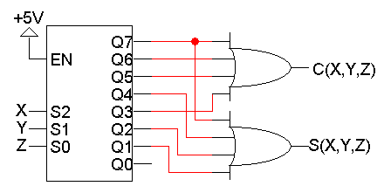
Using Decoders
We can already convert truth tables to circuits easily, with decoders.
For example, you can think of this old circuit as a memory that “stores” the sum and carry outputs from the truth table on the right.

Slide 55
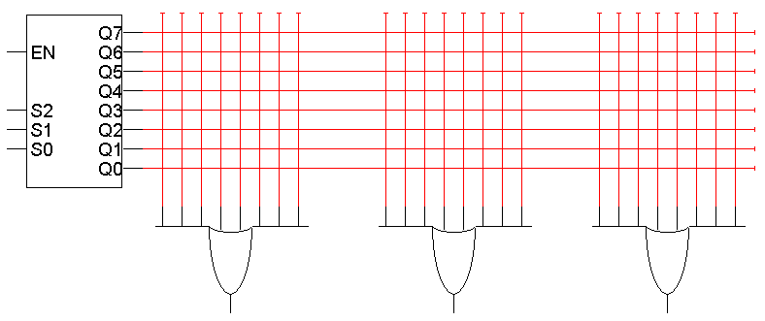
ROM setup
ROMs are based on this decoder implementation of functions.
A blank ROM just provides a decoder and several OR gates.
The connections between the decoder and the OR gates are “programmable,” so different functions can be implemented.
To program a ROM, you just make the desired connections between the decoder outputs and the OR gate inputs.

Slide 56
ROM Example
A₂
A₁
A₀
V₂ = Σm(1,2,3,4) V₁ = Σm(2,6,7) V₀ = Σm(4,6,7)
“Fuse” to form a connection, “blow” a fuse to disconnect
Here are three functions, V₂V₁V₀, implemented with an 8 x 3 ROM.
Blue crosses (X) indicate connections between decoder outputs and OR gates. Otherwise there is no connection.

Slide 57
A reminder
(a) Conventional symbol
(b) Array logic symbol
In PLD, the symbol in (b) is used.

Slide 58
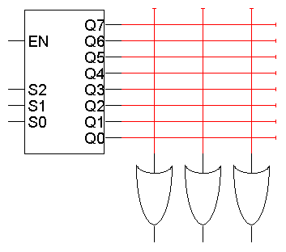
The same example again …
V₂ = Σm(1,2,3,4)
V₁ = Σm(2,6,7)
V₀ = Σm(4,6,7)
A₂
A₁
A₀
V₂ V₁ V₀
Here is an alternative presentation of the same 8 x 3 ROM, using “abbreviated” OR gates to make the diagram neater.

Slide 59
Why is this a “Memory”?
This combinational circuit can be considered a read-only memory.
It stores eight words of data, each consisting of three bits.
The decoder inputs form an address, which refers to one of the eight available words.
So every input combination corresponds to an address, which is “read” to produce a 3-bit data output.
A₂
A₁
A₀
V₂ V₁ V₀

Slide 60
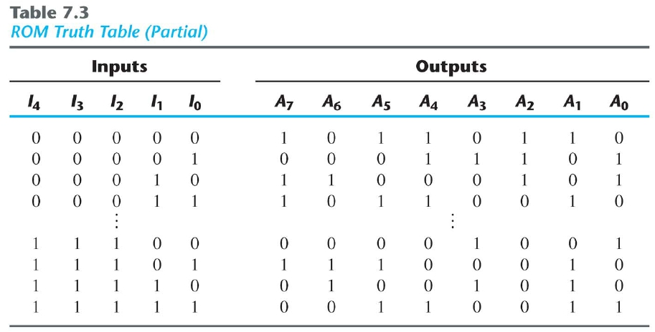
ROM Programming

Slide 61
ROM Programming
0
I0
1
2
I1
I2
I3
I4
3
.
.
.
28
29
30
31
5 x 32
Decoder
A7
A6
A5
A4
A3
A2
A1
A0

Slide 62
ROM Programming
0
I0
1
2
I1
I2
I3
I4
3
.
.
.
28
29
30
31
5 x 32
Decoder
A7
A6
A5
A4
A3
A2
A1
A0

Slide 63
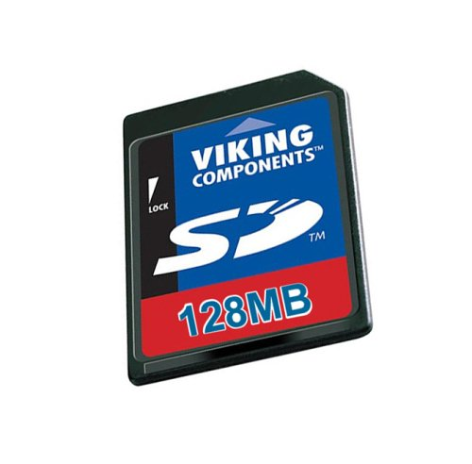
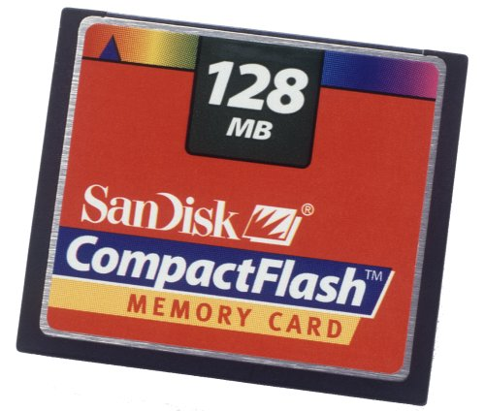
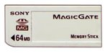
ROMs vs. RAMs
There are some important differences between ROM and RAM.
ROMs are “non-volatile”—data is preserved even without power. On the other hand, RAM contents disappear once power is lost.
ROMs require special (and slower) techniques for writing, so they’re considered to be “read-only” devices.
Some newer types of ROMs do allow for easier writing, although the speeds still don’t compare with regular RAMs.
MP3 players, digital cameras and other toys use CompactFlash, Secure Digital, or MemoryStick cards for non-volatile storage.
Many devices allow you to upgrade programs stored in “flash ROM.”

Slide 64
Programmable Logic Arrays
A ROM is potentially inefficient because it uses a decoder, which generates all possible minterms. No circuit minimization is done.
Using a ROM to implement an n-input function requires:
An n-to-2^{n} decoder (which uses n inverters and 2^{n} n-input AND gates; and an OR gate with up to 2^{n} inputs).
The number of gates roughly doubles for each additional ROM input.
A programmable logic array, or PLA, makes the decoder part of the ROM “programmable” too.
Instead of generating all minterms, you can choose which products (not necessarily minterms) to generate.

Slide 65
Programmable Logic Array (PLA)
Pre-fabricated building block of many AND/OR gates
Actually NOR or NAND
“Personalized” by making or breaking connections among gates
Programmable array block diagram for sum of products form
• • •
Inputs
AND Array
OR Array
Product Terms
Outputs
• • •

Slide 66
PLA vs ROM
• • •
• • •
Inputs
inputs
AND Array
OR Array
OR Array
Decoder
outputs
outputs
• • •
• • •

Slide 67
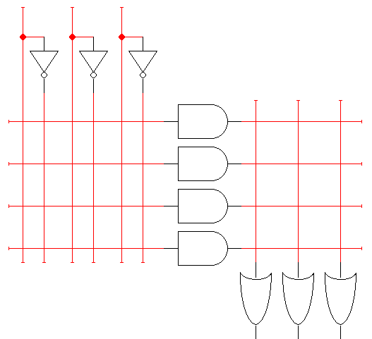
A blank 3 x 4 x 3 PLA
This is a 3 x 4 x 3 PLA (3 inputs, up to 4 product terms, and 3 outputs), ready to be programmed.
The left part of the diagram replaces the decoder used in a ROM.
Connections can be made in the “AND array” to produce four arbitrary products, instead of 8 minterms as with a ROM.
Those products can then be summed together in the “OR array.”
Inputs
OR array
AND array
Outputs

Slide 68
Regular K-map minimization
The normal K-map approach is to minimize the number of product terms for each individual function.
For our three functions, this would result in a total of six different product terms.
V₂ V₁ V₀
V₂ = Σm(1,2,3,4)
V₁ = Σm(2,6,7)
V₀ = Σm(4,6,7)

Slide 69
PLA minimization
For a PLA, we should minimize the number of product terms for all functions together.
We could express V₂, V₁ and V₀ with just a total of four products:
V₂ = xy’z’ + x’z + x’yz’ V₁ = x’yz’ + xy V₀ = xy’z’ + xy

Slide 70
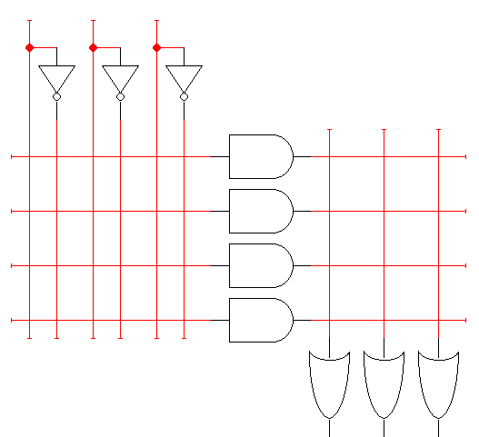
PLA example
So we can implement these three functions using a 3 x 4 x 3 PLA:
x y z
xy’z’
xy
x’z
x’yz’
V₂ = Σm(1,2,3,4) = xy’z’ + x’z + x’yz’
V₁ = Σm(2,6,7) = x’yz’ + xy
V₀ = Σm(4,6,7) = xy’z’ + xy
V₂ V₁ V₀

Slide 71
PLA programming example
Enabling concept: Shared product terms among outputs.
Implement the following function(s) using PLA.
F₀ = A + B' C'
F₁ = A C' + A B
F₂ = B' C' + A B
F₃ = B' C + A

Slide 72
PLA programming example
Input side:
F₀ = A + B' C'
F₁ = A C' + A B
F₂ = B' C' + A B
F₃ = B' C + A
1 : uncomplemented in term
0 : complemented in term
– : does not participate
Output side:
1 : term connected to output
0 : no connection to output
PLA programming table:
Product Inputs Outputs
Term A B C F₀ F₁ F₂ F₃
AB 1 1 – 0 1 1 0 B'C – 0 1 0 0 0 1 AC' 1 – 0 0 1 0 0 B'C' – 0 0 1 0 1 0 A 1 – – 1 0 0 1
reuse of terms

Slide 73
Before Programming
All possible connections available before "programming"

Slide 74
After Programming
Unwanted connections are "blown“
Final, programmed PLA:
A
B
C
AB
B'C
AC'
B'C'
A
F₀ = A + B' C'
F₁ = A C' + A B
F₂ = B' C' + A B
F₃ = B' C + A
F₀
F₁
F₂
F₃

Slide 75
Another example
Implement the following using a 4x4x4 PLA:
F₀ = A B + A' B'
F₁ = C D' + C' D
Before programming:
After programming:
A
B
C
D
AB
A'B'
CD'
C'D
AB+A'B'
CD'+C'D

Slide 76
One more example: a full decoder can be implemented in the programmable AND part
full decoder as for memory address
bits stored in memory
A
B
C
A'B'C'
A'B'C
A'BC'
A'BC
AB'C'
AB'C
ABC'
ABC
A B C F₁ F₂ F₃ F₄ F₅ F₆
0 0 0 0 0 1 1 0 0
0 0 1 0 1 0 1 1 1
0 1 0 0 1 0 1 1 1
0 1 1 0 1 0 1 0 0
1 0 0 0 1 0 1 1 1
1 0 1 0 1 0 1 0 0
1 1 0 0 1 0 1 0 0
1 1 1 1 1 0 0 1 1
F₁
F₂
F₃
F₄
F₅
F₆
Multiple functions of A, B, C
F₁ = A B C
F₂ = A + B + C
F₃ = A' B' C'
F₄ = A' + B' + C'
F₅ = A xor B xor C
F₆ = A xnor B xnor C

Slide 77
PLA evaluation
A k x m x n PLA can implement up to n functions of k inputs, each of which must be expressible with no more than m product terms.
Unlike ROMs, PLAs allow you to choose which products are generated.
This can significantly reduce the fan-in (number of inputs) of gates, as well as the total number of gates.
However, a PLA is less general than a ROM. Not all functions may be expressible with the limited number of AND gates in a given PLA.
In terms of memory, a k x m x n PLA has k address lines, and each of the 2^{k} addresses references an n-bit data value (so, word size is n bits).
But again, not all possible data values can be stored.

Slide 78
Functions and memories
ROMs and PLAs give us two more ways to implement functions.
A circuit implies that some calculation has to be done on the inputs in order to arrive at the output. If the same inputs are given again, we have to repeat that calculation.
A truth table lists all possible combinations of inputs and their corresponding outputs. Instead of doing a potentially lengthy calculation, we can just “look up” the result of a function.
The idea behind using a ROM or PLA to implement a function is to “store” the function’s truth table, so we don’t have to do any (well, very little) computation.
This is like “memorization” or “caching” techniques in programming.

Slide 79
Important points so far…
There are two main kinds of random access memory.
Static RAM costs more, but the memory is faster. Static RAM is often used to implement cache memories.
Dynamic RAM costs less and requires less physical space, making it ideal for larger-capacity memories. However, access times are also slower.
ROMs and PLAs are programmable devices that can implement arbitrary functions, which is equivalent to acting as a read-only memory.
ROMs are simpler to program, but contain more gates.
PLAs use less hardware, but it requires some effort to minimize a set of functions. Also, the number of AND gates available can limit the number of expressible functions.

Slide 80
Programmable Logic Devices (PLDs)
Fixed
AND array
(decoder)
Programmable
OR array
Inputs
Outputs
(a) Programmable read-only memory (PROM)
Inputs
Programmable
AND array
Programmable
OR array
Outputs
(c) Programmable logic array (PLA)
Inputs
Programmable
AND array
Fixed
OR array
Outputs
(b) Programmable array logic (PAL)

Slide 81
PALs and PLAs
Programmable logic array (PLA)
what we've seen so far
unconstrained fully-general AND and OR arrays
Programmable array logic (PAL)
Seen on the right
constrained topology of the OR array
faster and smaller OR plane
a given column of the OR array has access to only a subset of the possible product terms

Slide 82
PALs and PLAs: Design Example
BCD to Gray code converter
A B C D W X Y Z 0 0 0 0 0 0 0 0 0 0 0 1 0 0 0 1 0 0 1 0 0 0 1 1 0 0 1 1 0 0 1 0 0 1 0 0 0 1 1 0 0 1 0 1 1 1 1 0 0 1 1 0 1 0 1 0 0 1 1 1 1 0 1 1 1 0 0 0 1 0 0 1 1 0 0 1 1 0 0 0 1 0 1 – – – – – 1 1 – – – – – –
A
A
0 0 X 1
0 1 X 1 0 1 X X
0 1 X X
0 1 X 0
0 1 X 0 0 0 X X
0 0 X X
D
D
C
C
B
B
K-map for W
K-map for X
A
A
0 1 X 0
0 1 X 0 1 1 X X
1 1 X X
0 0 X 1
1 0 X 0 0 1 X X
1 0 X X
Minimized Functions:
W = A + B D + B C
X = B C'
Y = B + C
Z = A’ B’ C’ D + B C D + A D' + B' C D'
D
D
C
C
B
B
K-map for Y
K-map for Z

Slide 83
PALs and PLAs: design example (cont’d)
Code converter: programmed PAL
A
B.D
B.C
0
B.C'
0
0
0
B
C
0
0
A’.B’.C’.D
B.C.D
A.D'
B’.C.D'
Minimized Functions:
W = A + B.D + B.C
X = B.C'
Y = B + C
Z = A’.B’.C’.D + B.C.D + A.D' + B’.C.D'
not a particularly good
candidate for PAL/PLA
implementation since no terms are shared among outputs
however, much more compact and regular implementation when compared with discrete AND and OR gates
W X Y Z

Slide 84
PALs and PLAs: Another Design Example
Is the following a PAL or a PLA?
A
A
1 0 0 0
0 1 0 0 0 0 1 0
0 0 0 1
0 1 1 1
1 0 1 1 1 1 0 1
1 1 1 0
A B C D
A'B'C'D'
A'BC'D
ABCD
AB'CD'
AC'
A'C
B'D
BD'
A'B'D
B'CD
ABC
BC'D'
D
D
C
C
B
B
K-map for EQ
K-map for NE
EQ =A'B'C'D'+ A'BC'D
+ABCD + AB'CD’
NE = AC'+ B’D + BD’ + A'C
A
A
0 0 0 0
1 0 0 0 1 1 0 1
1 1 0 0
0 1 1 1
0 0 1 1 0 0 0 0
0 0 1 0
D
D
C
C
B
B
K-map for LT
K-map for GT
LT = A'B'D +A'C+B'CD
GT =B C'D'+AC'+ABD'
EQ NE LT GT
Magnitude comparator (AB vs. CD)

Slide 85
Sequential programmable devices
Consists of programmable combinational logic + memory
There are several types:
1. Sequential (or simple) programmable logic devices (SPLD)
2. Complex programmable logic devices (CPLD)
3. Field-programmable gate array (FPGA)

Slide 86
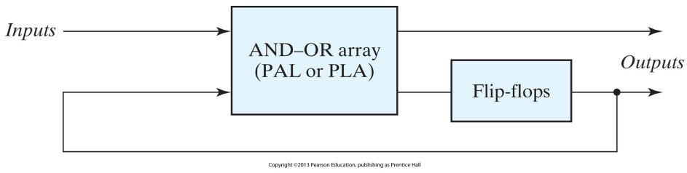
SPLD

Slide 87
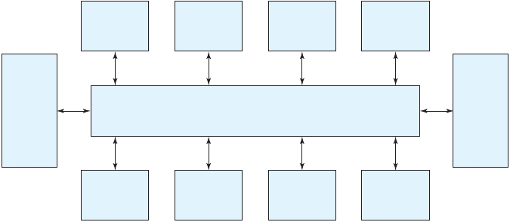
CPLD
PLD
PLD
PLD
PLD
I/O
I/O
Programmable Switch Matrix
block
block
PLD
PLD
PLD
PLD

Slide 88
FPGA
A VLSI circuit that can be programmed at the user’s location.
A typical FPGA consists of an array of millions of logic blocks, surrounded by programmable input and output blocks and connected together via programmable interconnections.
A typical FPGA logic block consists of lookup tables, multiplexers, gates, and flip‐flops.

Slide 89
Examples

Slide 90
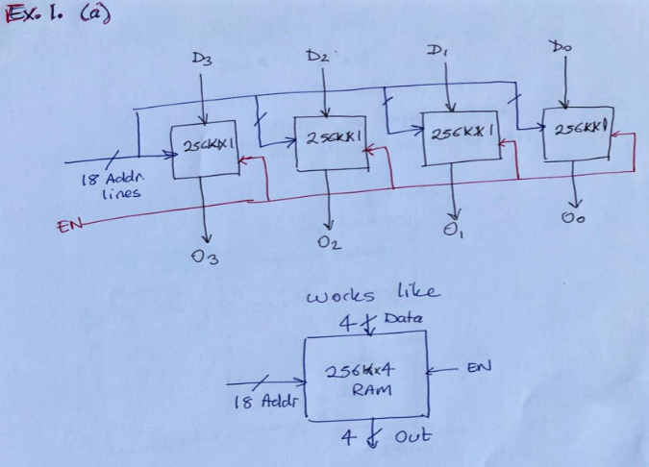
Design the following memory chips using 256K x 1 RAM chips.
256K x 4 RAM

Slide 91
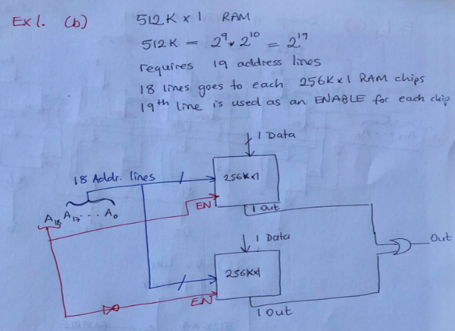
Design the following memory chips using 256K x 1 RAM chips.
512K x 1 RAM

Slide 92
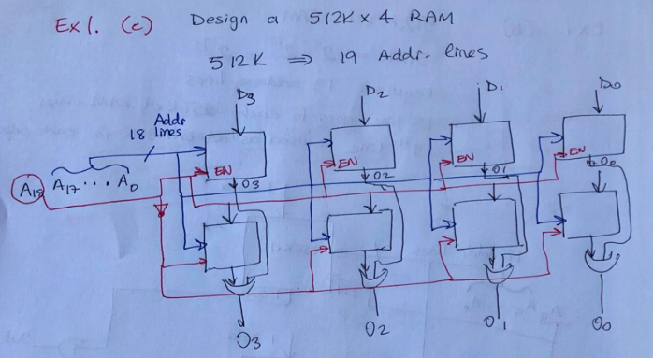
Design the following memory chips using 256K x 1 RAM chips.
512K x 4 RAM

Slide 93
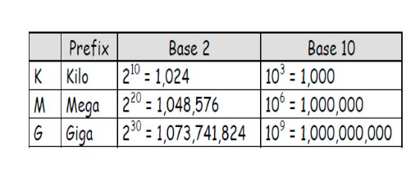
How many address lines and data lines are needed for the following RAM chips
8K x 32
2G x 8
16M x 32
256K x 64

Slide 94
How many address lines and data lines are needed for the following RAM chips
8K x 32 = 2^3 * 2^10 x 32 --> A = 13 D = 32
2G x 8 = 2^2 * 2^30 x 8 --> A = 32 D = 8
16M x 32 = 2^4 *2^20 x 32 --> A = 24 D = 32
256K x 64 = 2^8 *2^10 x 64 --> A = 18 D = 64

Slide 95
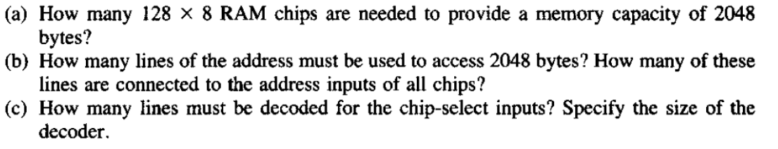
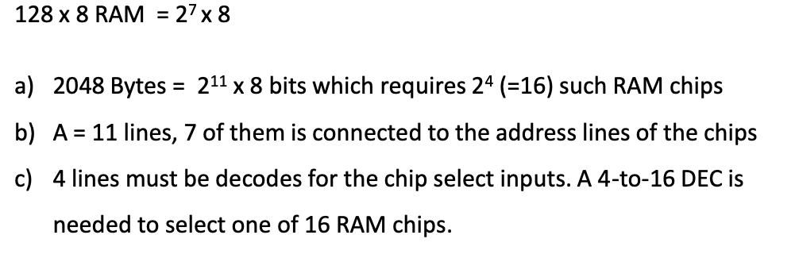

Slide 96
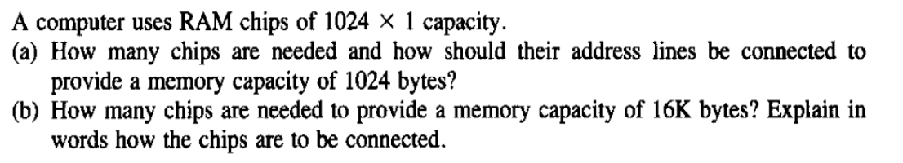
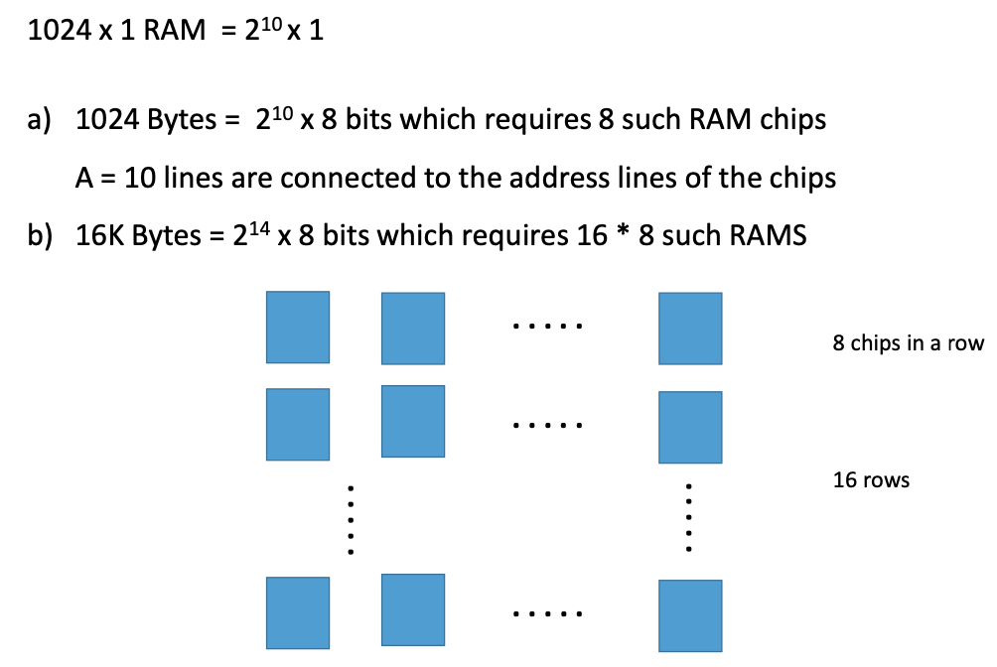

Slide 97
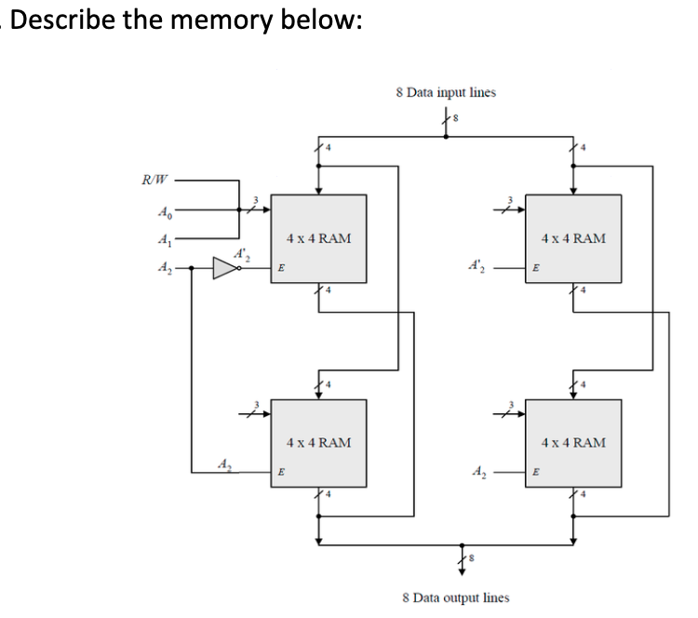

Slide 98
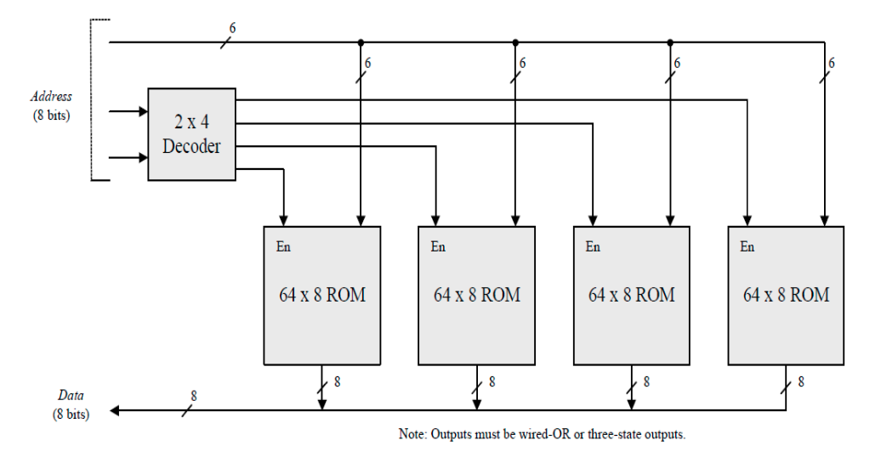
Using 64 x 8 ROM chips with an enable input, construct a 512 x 8 ROM with eight chips and a decoder.

Slide 99
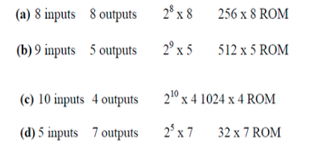
Specify the size of a ROM (number of words and number of bits per word) that will accommodate the truth table for the following combinational circuit components:
(a) a binary multiplier that multiplies two 4‐bit binary words,
(b) a 4‐bit adder–subtractor,
(c) a quadruple two‐to‐one‐line multiplexer with common select and enable inputs, and
(d) a BCD‐to‐seven‐segment decoder with an enable input.

Slide 100
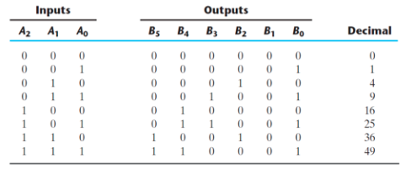
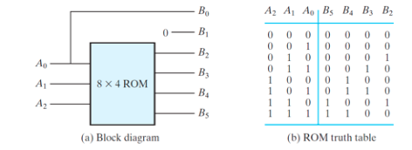
Derive the ROM programming table for the combinational circuit that squares a three‐bit number.

Slide 101
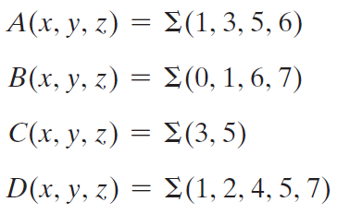
Tabulate the PLA programming table for the four Boolean functions listed below. Minimize the number of product terms.

Slide 102
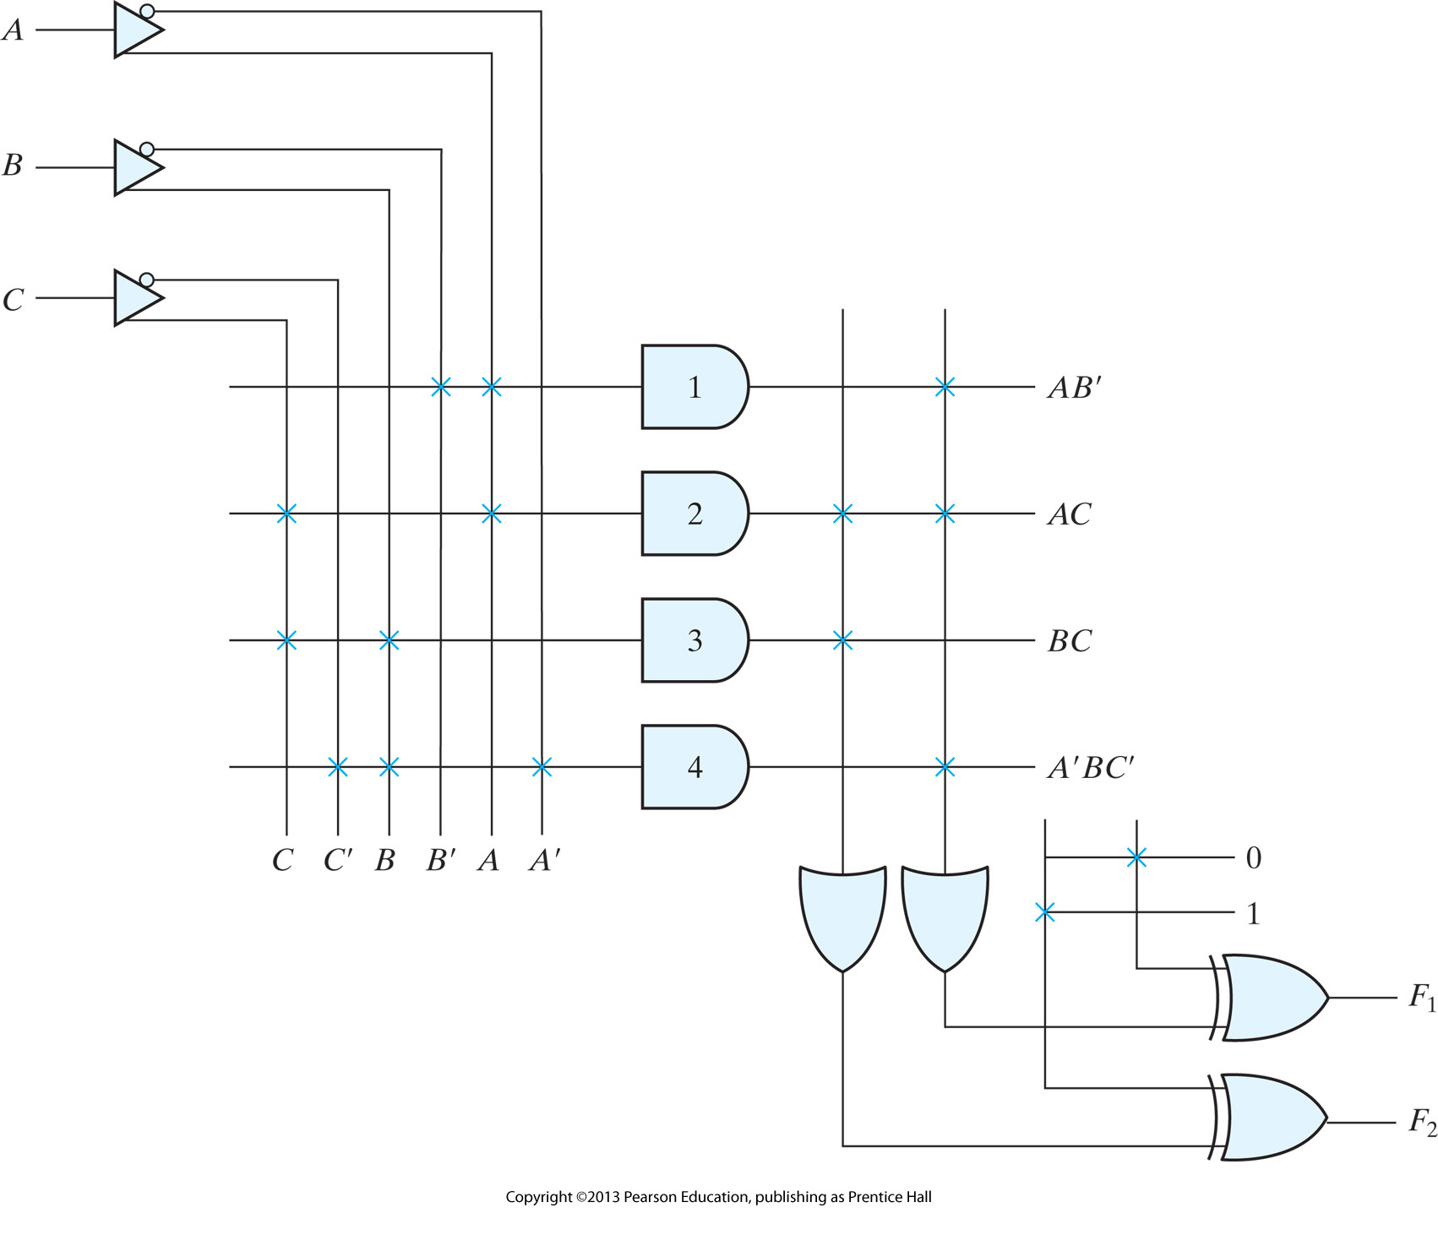
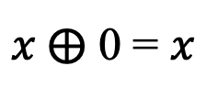
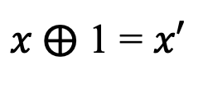
$x ⨁$ 1 = $x′$
$x ⨁$ 0 = $x$

Slide 103
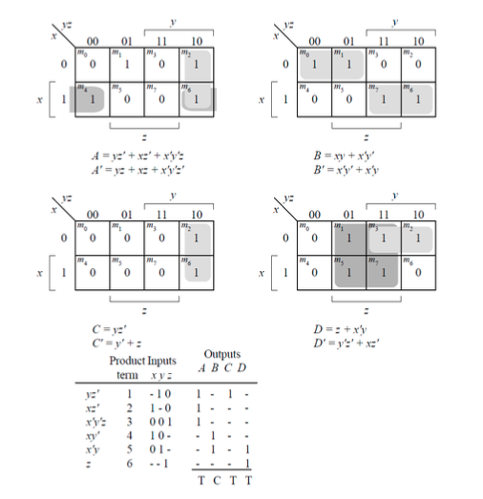
B’= xy’ + x’y

Slide 104


The following is a truth table of a three‐input, four‐output combinational circuit
Tabulate the PAL programming table for the circuit, Use a 4 input, 4 output PAL with 3 input OR gates.

Slide 105



